Slide 1
Good Intentions and Community

Slide 3
Revelation 22:17 The Spirit and the bride say “Come!”. And let him who hears say, “come!”. Whoever is thirsty, let him come; and whoever wishes, let him take the free gift of the water of life.

Slide 4
1. Jesus’ Bride – the Church
Ephesians 5:25-27 Husbands, love your wives, just as Christ loved the church and gave himself up for her to make her holy, cleansing her by the washing with water through the word, and to present her to himself as a radiant church, without stain or wrinkle or any other blemish, but holy and blameless.
Ephesians 5:31-32 For this reason a man will leave his father and mother and be united to his wife, and the two will become one flesh. This is a profound mystery – but I am talking about Christ and the church.

Slide 5
1. Jesus’ Bride – the Church
Revelation 19:7-8 Let us rejoice and be glad and give him glory! For the wedding of the Lamb has come, and his bride has made herself ready. Fine linen, bright and clean, was given her to wear. (Fine linen stands for the righteous acts of the saints.)

Slide 6
2. Living it Out.
Colossians 3:12-13 Therefore, as God’s chosen people, holy and dearly loved, clothe yourselves with compassion, kindness, humility, gentleness and patience. Bear with one another and forgive whatever grievances you may have against one another. Forgive as the Lord forgave you.
Colossians 3:14 And over all these virtues put on love, which binds them al together in perfect unity.
Colossians 3:15 Let the peace of Christ rule in your hearts, since as members of one body you were called to peace. And be thankful.

Slide 7
3. Training for Relationships
Proverbs 22:6 Train up a child in the way he should go, and when he is old, he will not turn from it.
Proverbs 29:15, 17 The rod of correction imparts wisdom, but a child left to himself disgraces his mother… Discipline your son, and he will give you peace; he will bring delight to your soul.
Ephesians 6:4 Fathers, do not exasperate your children; instead, bring them up in the training and instruction of the Lord.

Slide 8
4. Building Relationships
Proverbs 17:17 A friend loves at all times, and a brother is born for adversity.
Proverbs 27:5-6 Better is open rebuke than hidden love. Wounds from a friend can be trusted, but an enemy multiplies kisses.

Slide 9
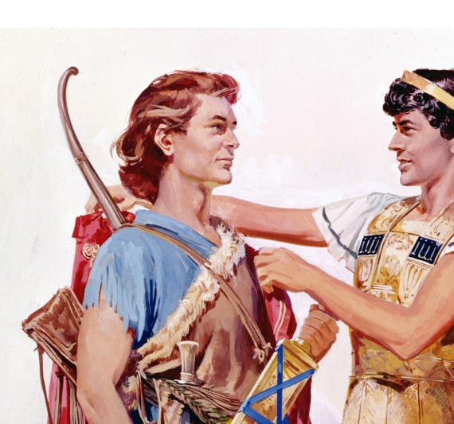
4. Building Relationships
1 Samuel 18:1-3 After David had finished talking with Saul, Jonathan became one in spirit with David, and he loved him as himself. From that day, Saul kept David with him and did not let him return to his father’s house. And Jonathan made a covenant with David because he loved him as himself.

Slide 10
John 15:15 I no longer call you servants, because a servant does not know his master’s business. Instead, I have called you friends, for everything that I learned from my father I have made known to you.

